Slide 1

Research Methods in Computing and Technology CT098-3-2
Research & Literature Searches

Slide 2
Topic and structure of the lesson
Research & Literature searches
What is research?
Research approaches for each discipline
Research resources
Library resources
Online resources
Printed resources
Evaluating research resources
Notes:
Research & Literature searches
What is research?
Research approaches for each discipline
Research resources
Library resources
Online resources
Printed resources
Evaluating research resources

Slide 3
Learning Outcomes
At the end of this session, you should be able to:
Explain what a research is
Understand the approaches to research for each discipline
Identify and evaluate the various research resources
Library resources
Online resources
Printed resources

Slide 4
What is a research?
“Systematic and purposeful investigation that includes the study of materials, sources, process, techniques in order to establish facts and reach new conclusions in computing.”
Original investigation undertaken in order to gain knowledge and understanding

Slide 5
Research approaches for each discipline
Body of Knowledge
represents the world’s understanding, theories, concepts, models, the sciences and the arts.
is stored in books, journal articles, conference proceedings, documents, reports, the Internet, people’s mind.

Slide 6
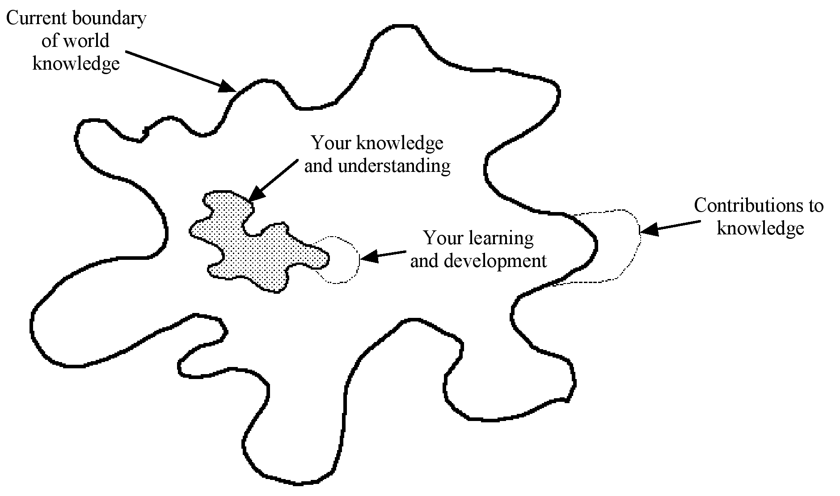
Contributions to Knowledge

Slide 7
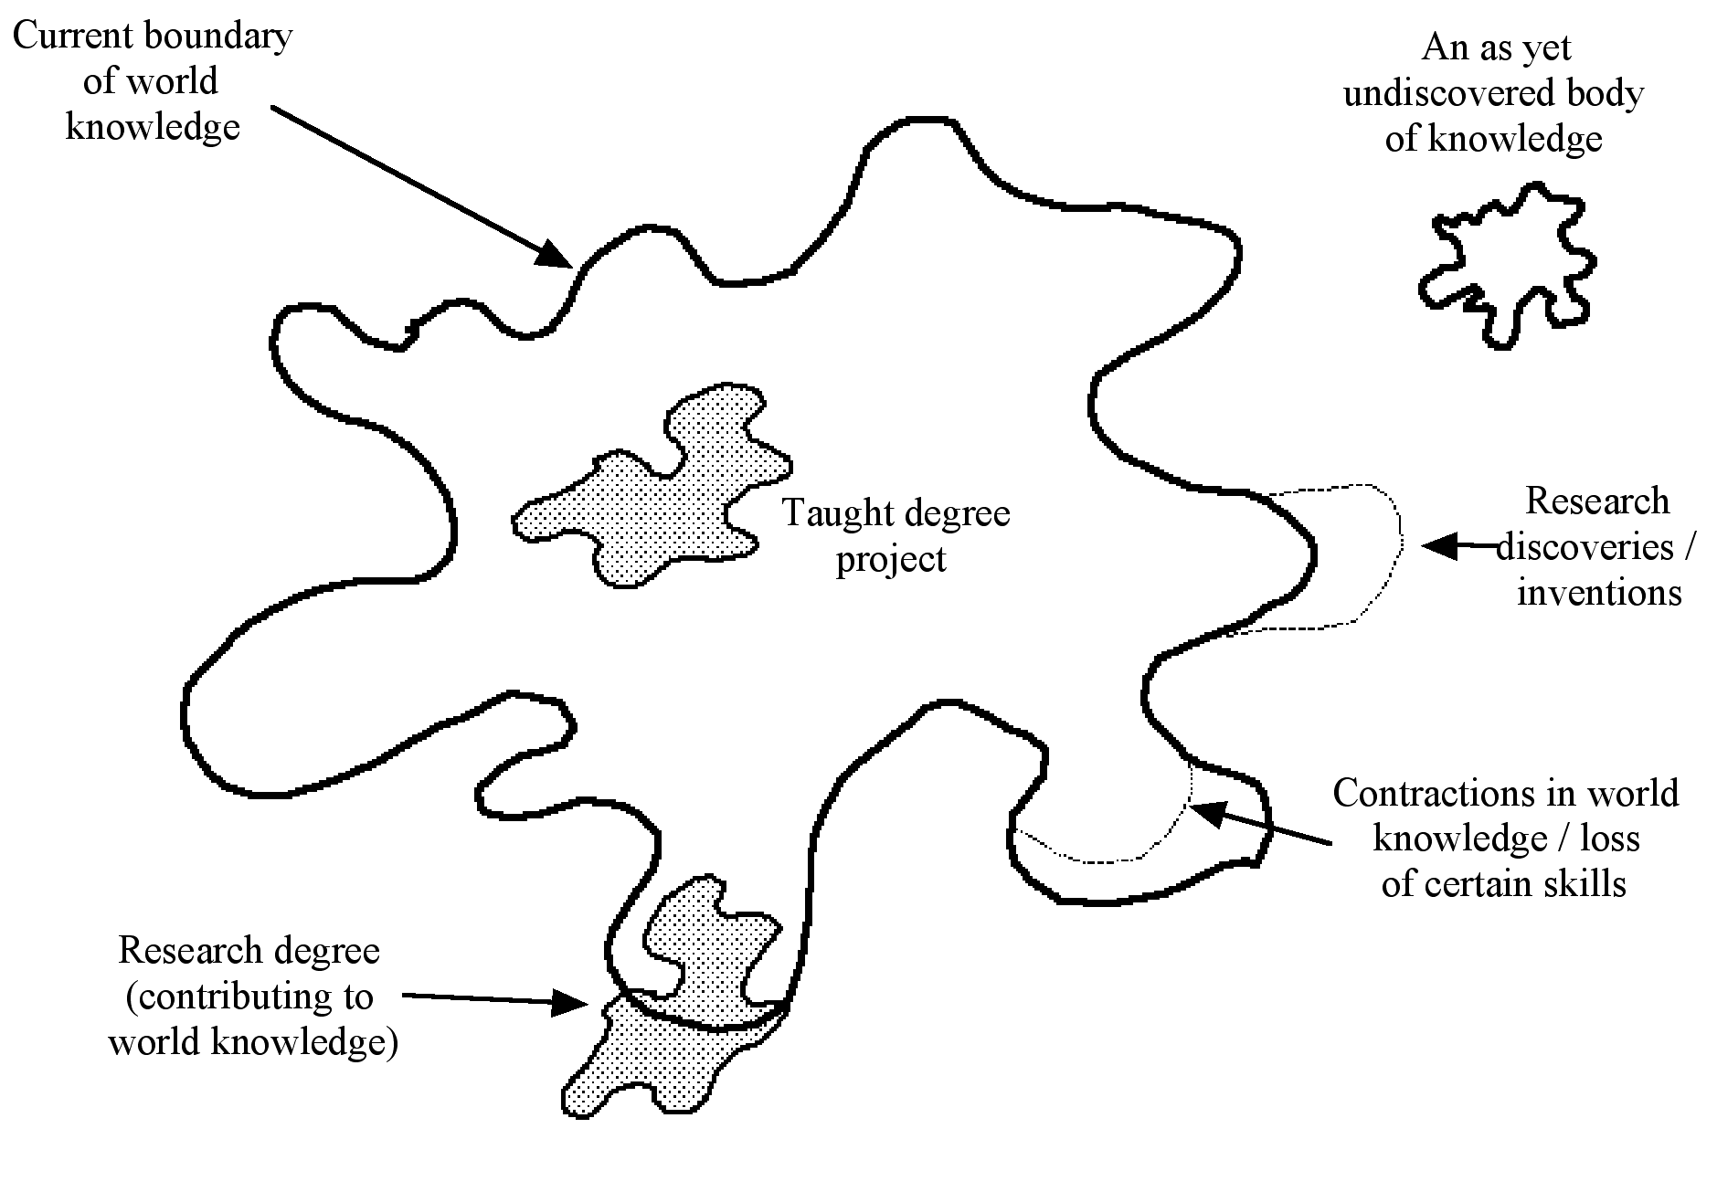
Projects within their wider context
Notes:
If you were pursuing a PhD or an Mphil, you project should be at the boundaries of world understanding in your particular field of study. Completing a PhD must enhance world knowledge – make a contribution to world knowledge and consequently expand the boundaries

Slide 8
The Research Process
Sequential
Generalised
Circulatory
Evolutionary
Notes:
Sequential – a research is a series of activities performed one after another as a fixed, linear series of stages; e.g. Systematic process model of Sharp et. Al (2002) or Greenfield (1996)
Generalised – identical to Sequential – defined sequence of activities performed one after another. In generalised – not all stages are applicable and some steps may require performing in different ways depending n the nature of the research – identifies alternative routes – Kane (1983)
Circulatory – any research is only part of a continuous cycle of discovery and investigation – research wheel (Rudestam and Newton, 2007)
Evolutionary – takes the circulatory to another level – research must evolve and change over time.
Orna and Stevens research process model (1995)

Slide 9
The Research Process
Sequential – a research is a series of activities performed one after another as a fixed, linear series of stages;
e.g. Systematic process model of Sharp et. al (2002) or Greenfield (1996)

Slide 10
The Research Process
In generalised – not all stages are applicable and some steps may require performing in different ways depending on the nature of the research – identifies alternative routes – Kane (1983)

Slide 11
The Research Process
Circulatory – any research is only part of a continuous cycle of discovery and investigation – research wheel (Rudestam and Newton, 2007)
Evolutionary – takes the circulatory to another level – research must evolve and change over time.
Orna and Stevens research process model (1995)

Slide 12
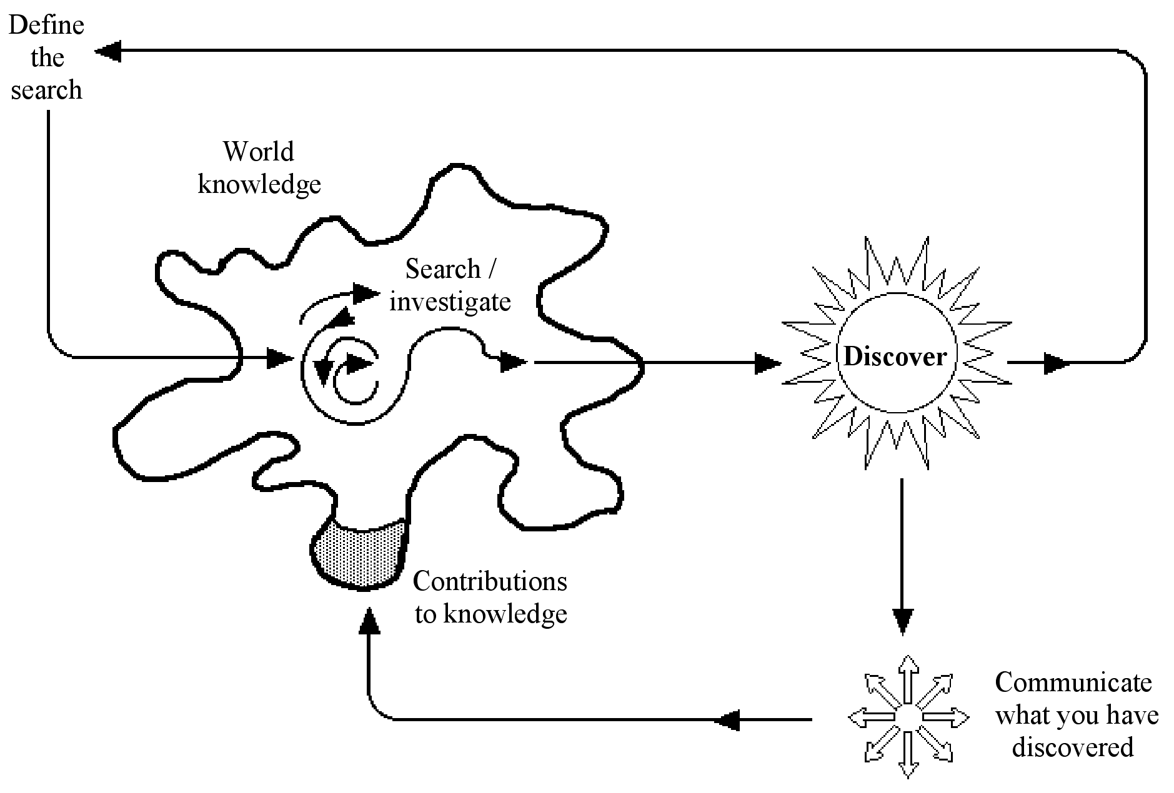
The real research process
Source: Adapted and reproduced with kind permission from Orna and Stevens (1995)

Slide 13
To find out
Was the previous model a real research process?
What is the current research process model?
Give a brief summary of how it works
Could this be counted as the real research process?

Slide 14
How to Find Sources
Look at literature in other disciplines
many topics overlap with various disciplines, thus further support of the study might be found in other disciplines
Scholarly journals, books, dissertations, government documents, reports, conference papers.

Slide 15
How to Find Sources…
Use the library to help you do the literature review.
Online catalogues of libraries
Internet – use search engines like Google Scholarly (URL: scholarly.google.com) and some databases like ACM or IEEExplore are available online.
Media e.g. newspaper, magazines (printed and online)
Government bodies – e.g. Statistics Department

Slide 16
Sources – Use sparingly
Dissertations
"Secondary sources, although useful to some degree, should be considered hearsay."
White papers
Personal communications
Popular journals, magazines, newspaper articles
Popular media

Slide 17
Scholarly Journals
Scholarly journals ALWAYS cite their sources in the form of footnotes, bibliographies and/or references.
Articles are written by a scholar in the field or by someone who has done research in the field.
Often present empirical data to test hypotheses or answer research questions.
Be aware of the different styles of referencing format used in the journals. Computing/Technology papers commonly use the IEEE referencing style though APA is also widely used.

Slide 18
Research Sources
Online
Sources
Library
Printed
Sources

Slide 19
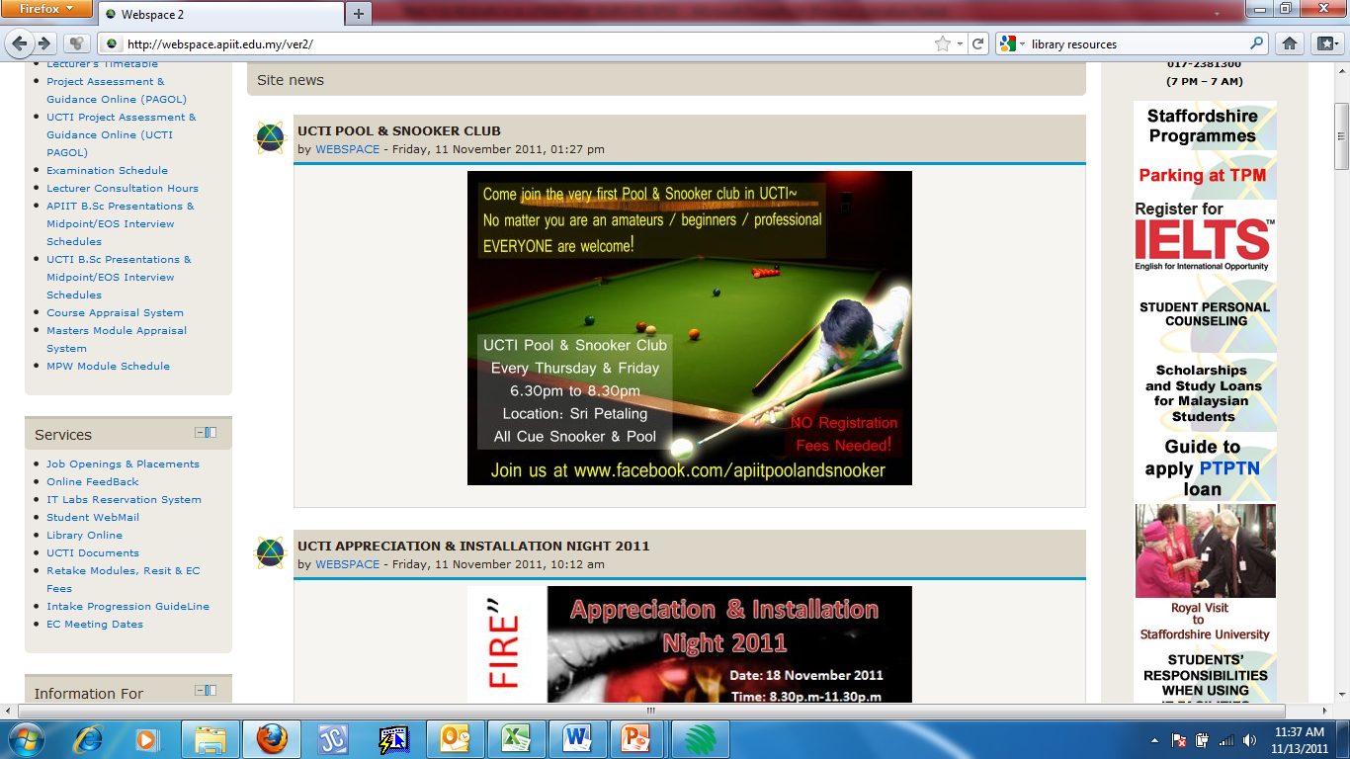

Slide 20
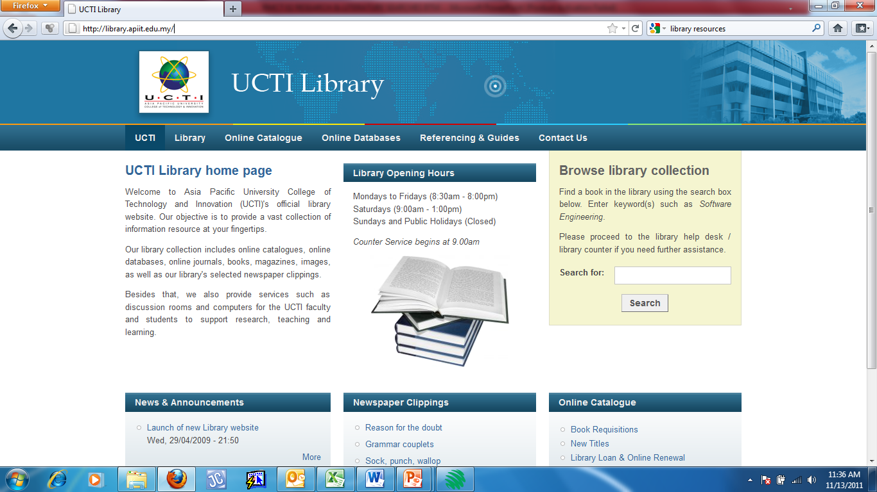

Slide 21
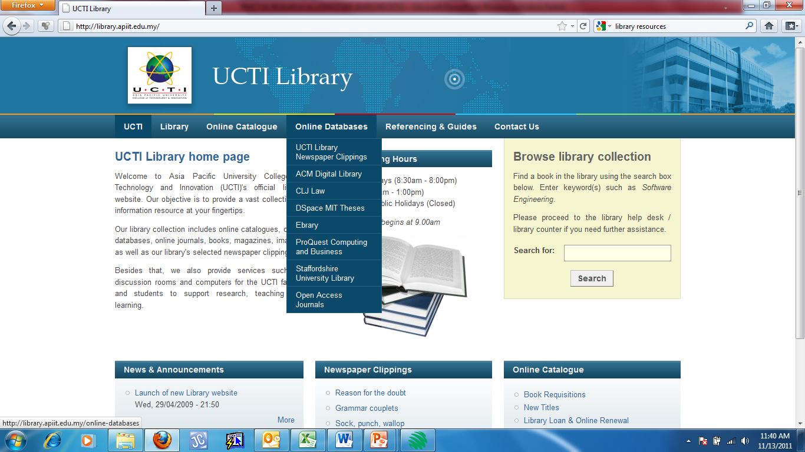

Slide 22
Sources of Information
Book
Comprehensive : complete and broad coverage of a subject
Substantive : in-depth coverage of a subject
Magazine
Popular : frequently encountered & widely accepted
Focused : addressed topic narrowly / specifically

Slide 23
Sources of Information
Journal
Scholarly : meeting standards accepted by academicians – appropriate for academic research
Authoritative : written / published by people / organisations with exepertise in subject area (IEEE)
Newspaper
Current : up-to-date / recent
Broad in scope : general / not focussed

Slide 24
Sources of Information
WWW
Accessible : easily obtained
Broad in scope : general / not focused

Slide 25
Quick Review Question
Compare and contrast the following sources of information that are usually used for research:
Books
Journals
Newspaper
Magazine
WWW

Slide 26
Primary vs Secondary Sources
 | Primary | Secondary
Definition | Sources that contain raw / original / non interpreted / unevaluated information | Sources that digest, analyse, evaluate, and interpret the information contained in primary research Tend to be argumentative
Format | Newspapers / weekly & monthly magazines / diaries / correspondence / letters | Articles in scholarly periodicals and books

Slide 27
Scholarly vs Non-Scholarly
 | Scholarly | Non-scholarly
Written by | Scholar / professional in the field | Professional writer – not an expert in the field
Citation | Always cite their sources of information – in footnote / bibliography | Rarely offers information (footnote / bibliography) about sources of information
Outcome | Gives research results Has specialised vocabulary Aimed at scholarly audience | text reports events and opinions aimed at general audience Easy to read
Document outlook | Cover and pages – plain in design with few / no pictures or graphics | Highly pictorial – has advertising

Slide 28
Scholarly vs Non-Scholarly
 | Scholarly | Non-scholarly
Publication | By Professional organisations, associations, scholarly groups, universities | For profit as a vehicle of opinion
Authors | Are always named & institutional affiliation named | Anonymous
Issue numbering | are successively numbered : issue 1, issue 2.... | Begin with page 1, page 2
Articles | Long | Short (1 – 2 pages)
Publication time frame | less often : Monthly, quarterly, semi-annually | More frequently: Monthly, weekly, daily

Slide 29
Scholarly vs Non-Scholarly
 | Scholarly | Non-scholarly
Found | In library / professional office | Any bookstore / convenience store
Source : http://www.stchas.edu/library/school/scholar

Slide 30
Quick Review Question
Explain why research students are encouraged to refer to scholarly sources rather than non-scholarly sources of information when doing their final year project research?

Slide 31
Sources
http://www.cs.bham.ac.uk/~pxc/refs/index.html
www.core.edu.au
Ranking of conferences and journals
http://www.scimagojr.com/

Slide 32
Q&A
Question

Slide 33
Next Topic
Idea Generation and Title Selection

